Slide 1
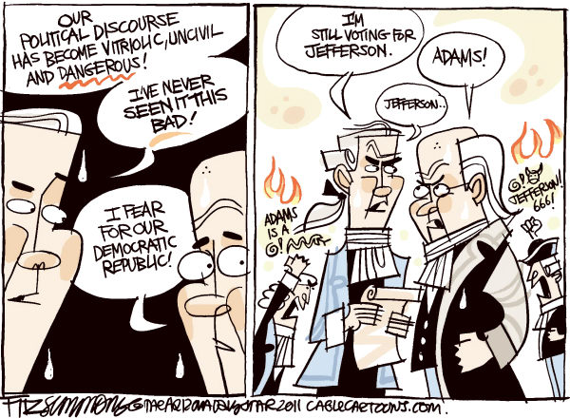
Linguistic Changes in Foreign Policy Political Discourse
Kayla jordan
Thesis proposal
Missouri state university

Slide 2
Introduction
Foreign policy - the choices a nation makes in relation to entities outside the nation
Kaufman (2010)
Role of the executive
Crichlow (2005), Dyson (2008), Dyson & Preston (2006)
Attitudes of the public
Cohrs & Moschner (2002), McCleary, Nalls, & Williams (2009), Sahar (2009)
Role of the legislative
Grimmer (2010), Kriner & Shen (2014)

Slide 3
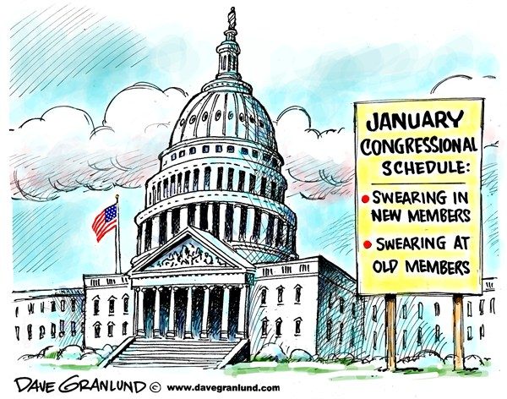
Importance of the Legislature
The power to declare war, limit the military engagement, and to control defense spending
Phelps & Boylan (2002)
Citizens’ perceptions
and approval
Ansolabehere &
Jones (2010)

Slide 4
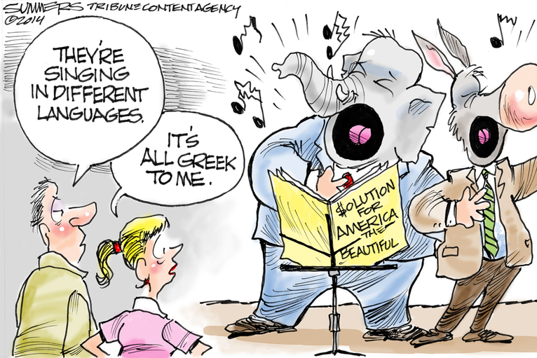
Language
Source of abundantly available data
Important to psychological constructs
Attentional focus
Group cohesion
Social status
Tausczik &
Pennebaker (2009)

Slide 5
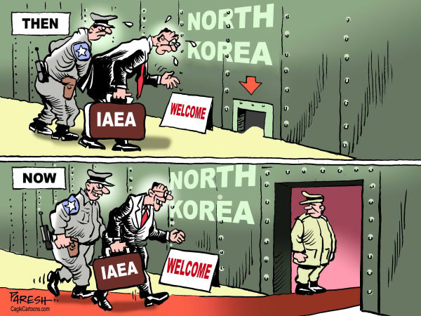
Purpose
To use word frequency analysis to understand U.S. congressmen and women’s positions and attitudes toward U. S. foreign policy with Iraq, Iran, and North Korea
To examine linguistic changes in the foreign policy discourse in Congress

Slide 6
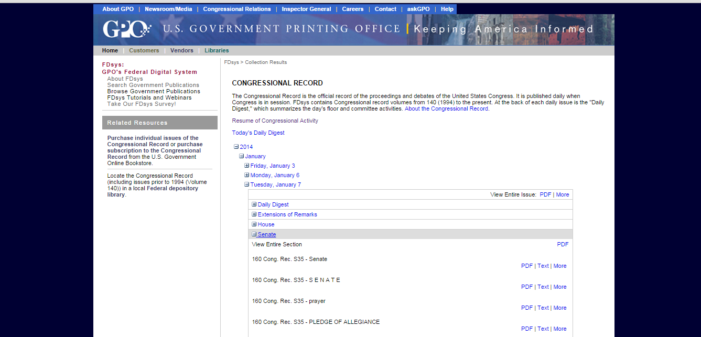
Congressional Record

Slide 7
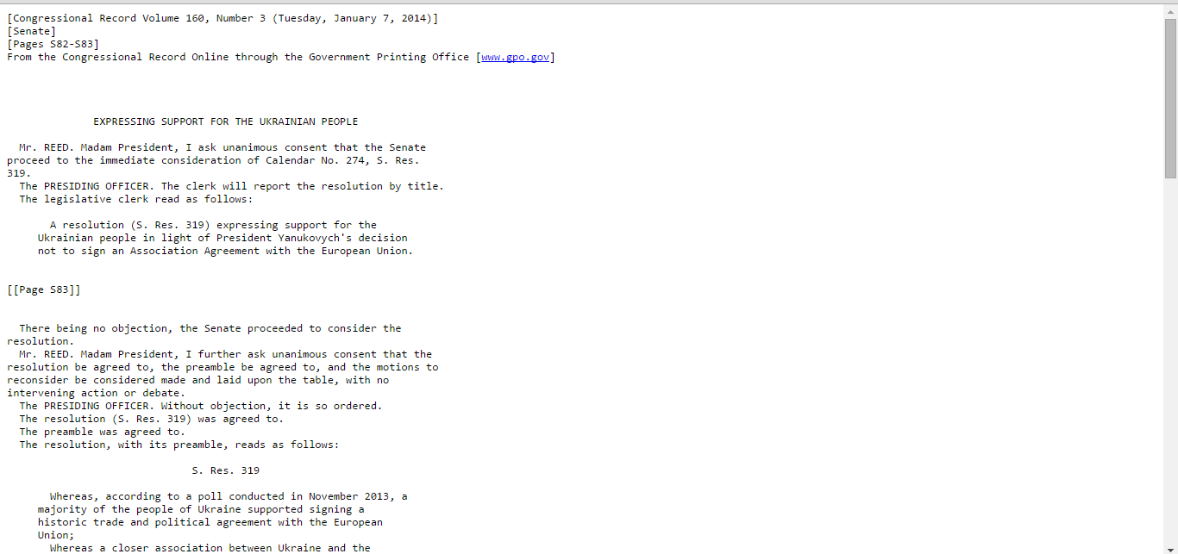
Congressional Record Entry

Slide 8
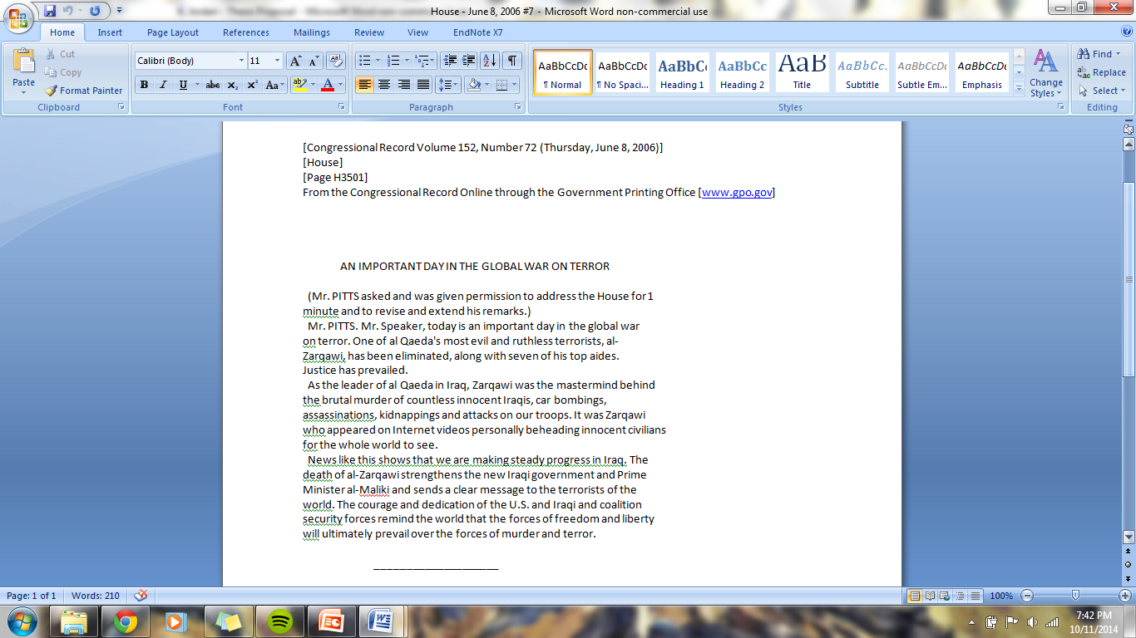
Unprocessed Text

Slide 9
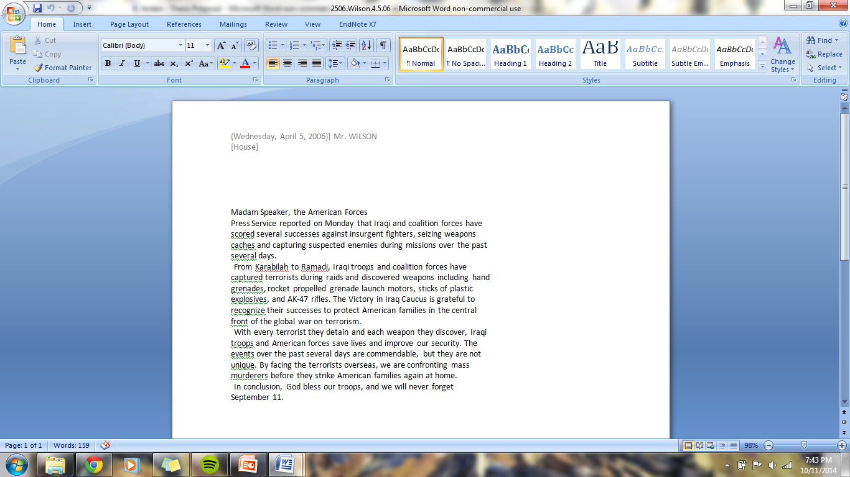
Processed Text

Slide 10
LIWC
82 language categories
Content and function words
Dictionary includes ≈ 4500 words and word stems
Each word is categorizes in one or more categories
For each category, total number of occurrences of all the words in that category is computed as a percentage of the total number of words in the document.

Slide 11
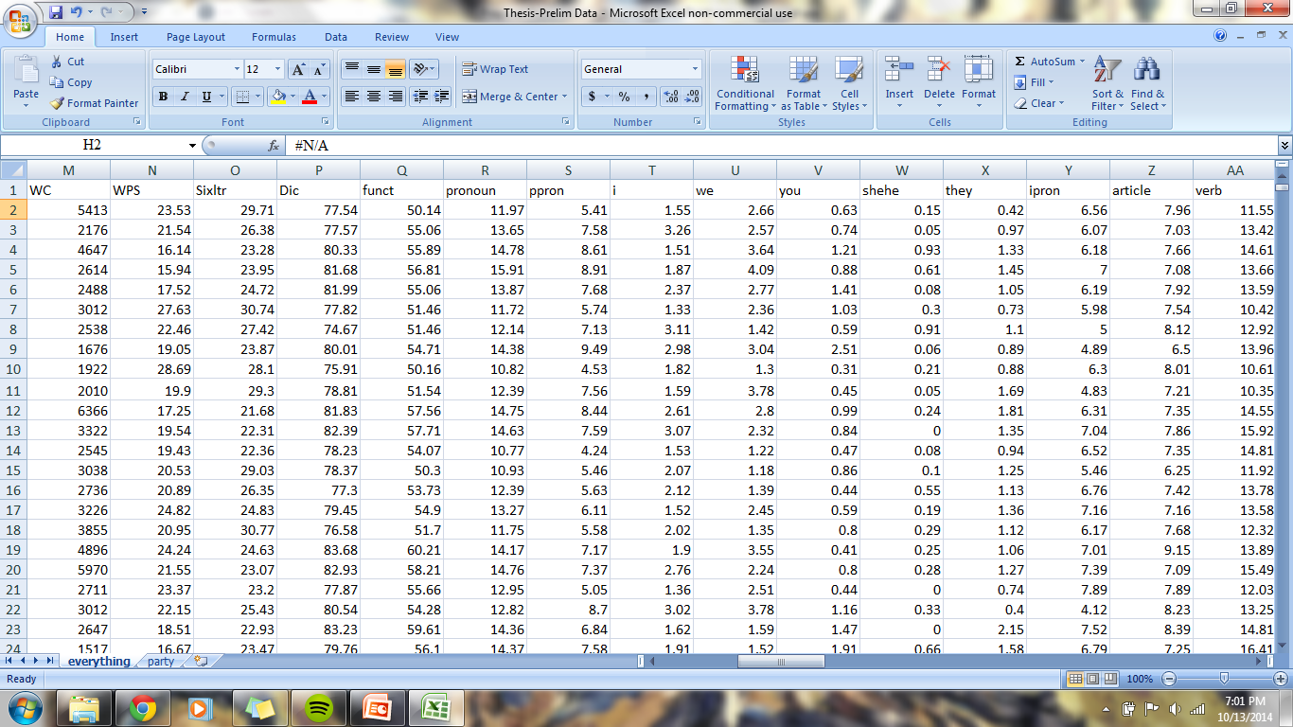
Data

Slide 12
Metalinguistic Constructs

Slide 13
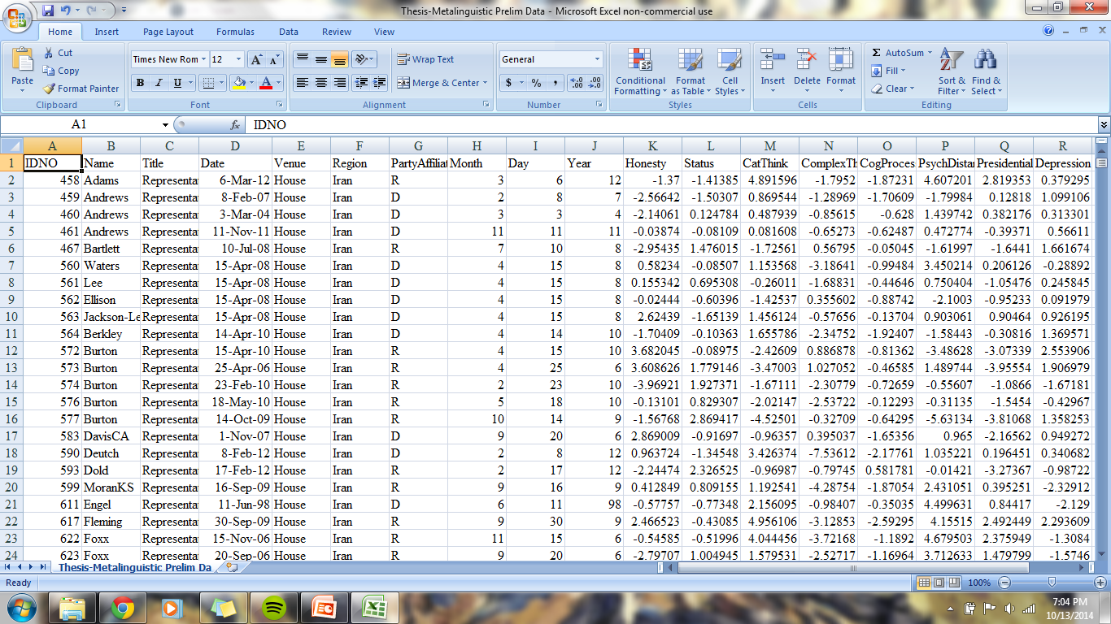
Constructs

Slide 14

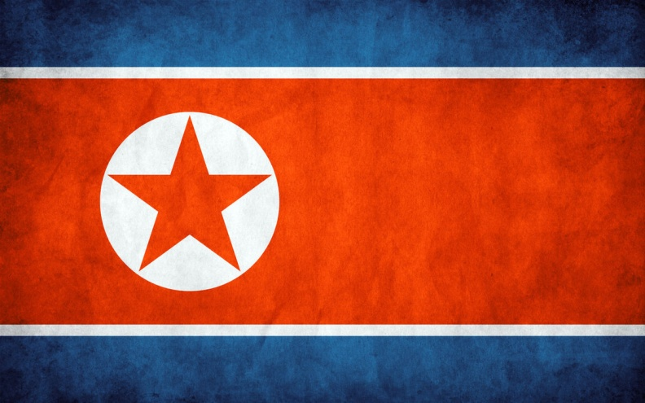

Estimated Sample Sizes
Iran ≈ 230
North Korea ≈ 120
Possible to increase sample size
with data from foreign affairs
committee hearings
Iraq ≈ 2400

Slide 15
Possible Covariates
Party Affiliation
Congressional chamber
State the speaker represents
Length speaker has been in Congress

Slide 16
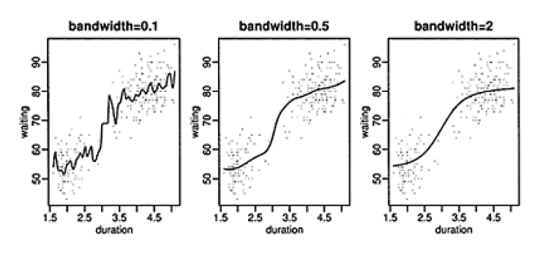
Proposed Data Analysis
Nonparametric regression
Smoothing splines
Possible 21 models (3 regions, 7 metalinguistic constructs)
Changes in slope
indicate change
in language
Connect events
to those changes

Slide 17
Alternatives
Multilevel modeling by event
Identify events
Examine language in a fixed period before the event and after the event
Multilevel modeling by year
Compare language across years (or other time interval) to determine linguistic changes
Could organize the data by party and/or state represented

Slide 18
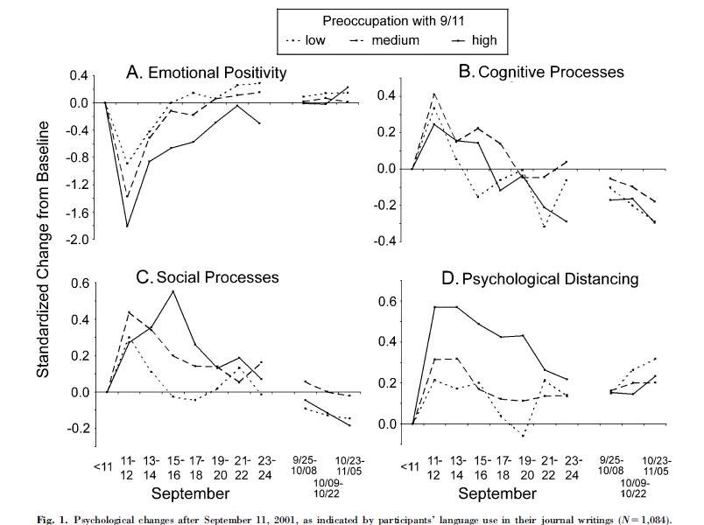
Cohn, Mehl, & Pennebaker (2004)

Slide 19
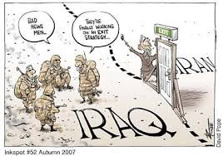
Outcomes
Understanding political language trends over time in the realm of foreign policy
Determining how events impact political language
Exploring how members of the U.S. Congress relate to “rogue” states

